Slide 1

Educational Institute Management System
Seyed Mojtaba Hosseini
Monroe College, King Graduate School
December 10, 2024
Prof. Eugene Adjei Djan

Slide 2
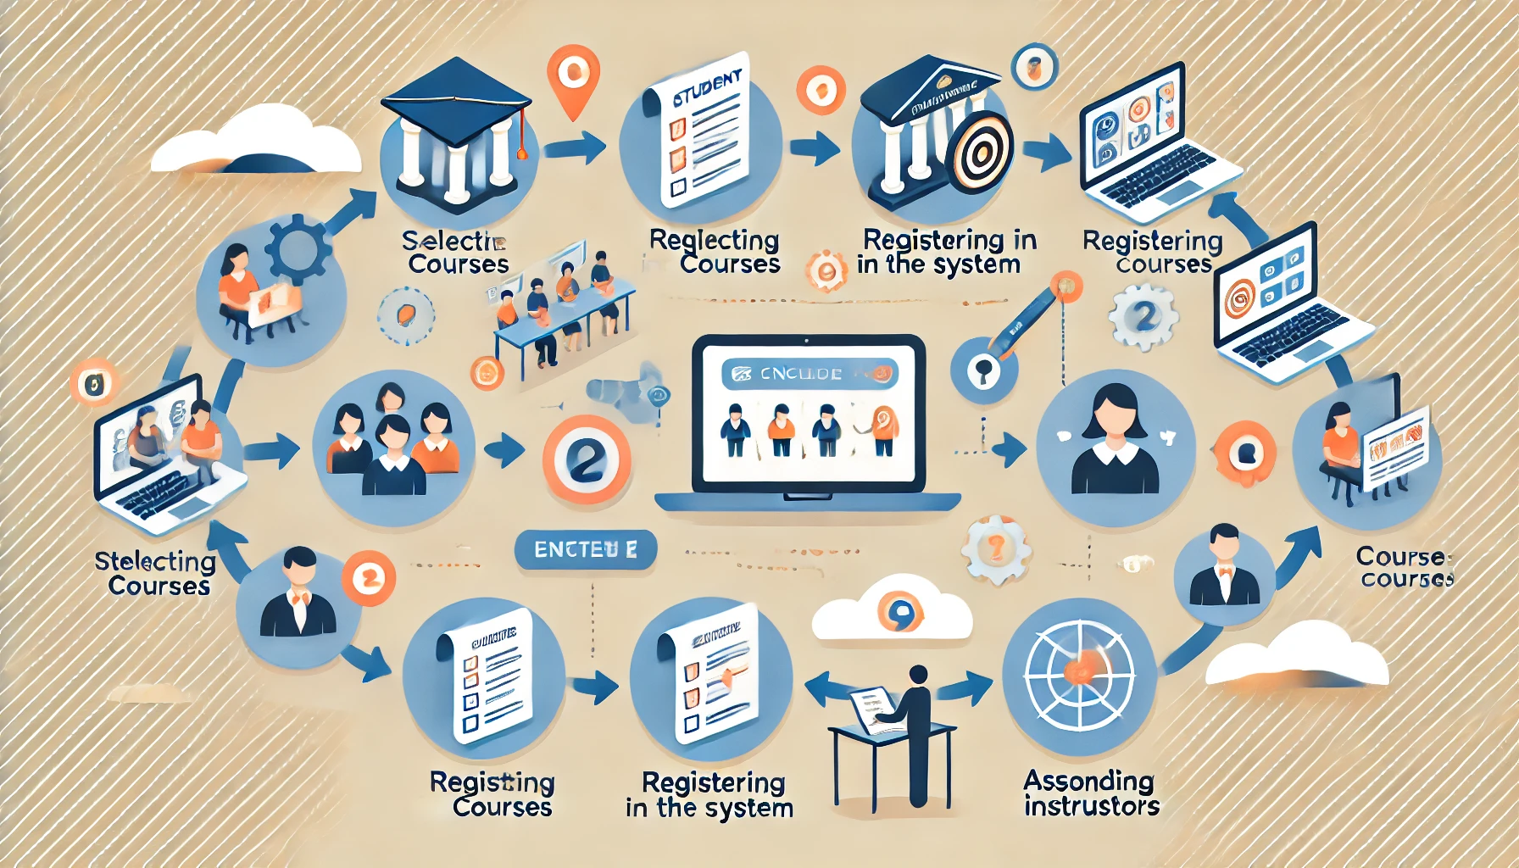
Project Overview
The Educational Institute Management System is designed to streamline the management of courses, departments, and enrollments.
Key features include:
- Course management
- Department management
- Student and instructor management
- Enrollment management
- A console User-friendly interface

Slide 3
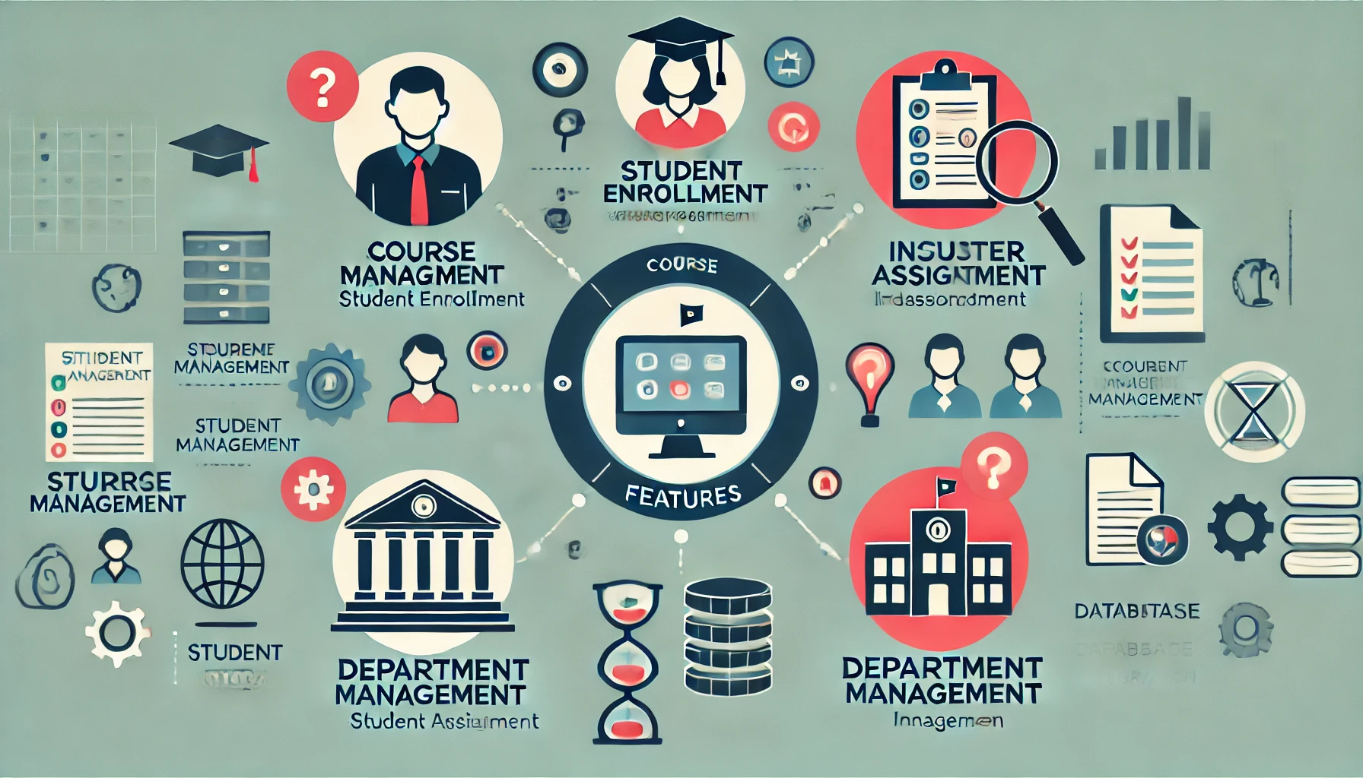
This Project Objectives
- Set up the basic project structure and define core classes: Person, Student, Instructor, Course, and Department.
- Implement basic functionality for enrolling students in courses and managing instructors.
- Create a basic user interface for students, instructors, and administrators to interact with the system.

Slide 4

Class Definitions: Person
- Base class for all people in the system (Students, Instructors, Admins).
- Properties: Name, ID, Email.
- Inherited by: Student, Instructor, Admin.

Slide 5

Class Definitions: Student
- Inherits from Person.
- Properties: EnrollmentDate, Major.
- Methods: RegisterForCourse(), ViewCourses(), DropCourse().

Slide 6

Class Definitions: Instructor
- Inherits from Person.
- Properties: Department, List of Courses taught.
- Methods: AssignGrades(), ViewCourses(), AssignHomework().

Slide 7
Class Definitions: Course
- Base class for all courses.
- Properties: CourseCode, CourseName, Department, Credits.
- Methods: EnrollStudent(), DropStudent(), AssignInstructor().

Slide 8
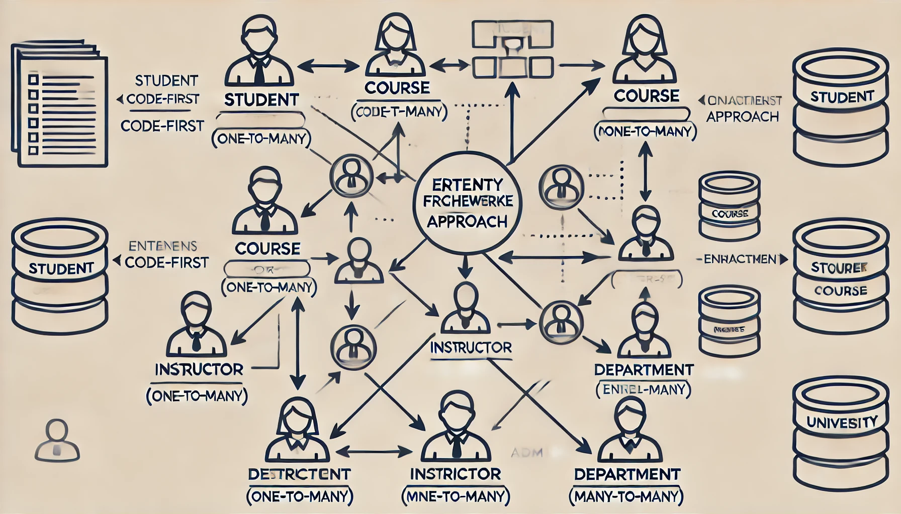
Code First Database Implementation
- Entity Framework is used to create the database using a Code-First approach..
-The DbContext class contains DbSet properties to map models to database tables.
- Relationship: One to Many & Many to Many

Slide 9
Handling Lazy and Eager Loading in DB
- Lazy Loading: Automatically loads related data when you access a navigation property (not recommended for performance-sensitive apps).
- Eager Loading: Preloads related data using Include to avoid additional database queries.

Slide 10
Conclusion and Thank You!
The system efficiently manages students, courses, instructors, and departments.
Code-First and Entity Framework provide a scalable solution for data management.
Challenges addressed: Lazy Loading, Eager Loading, and database structure.

